Slide 1
Performance Management Performance Review Authority Guidance
Updated July 2019

Slide 2
Guidance Purpose
Defines the role of the Performance Management Performance Review Authority (PM PRA)
Describes the timeline, structure, process and compliance issues relevant to the PM PRA
Provides an overview of how to conduct a statistical review of proposed employee ratings for both closeout early annual and year-end
This guidance is a supplement to AP-V 2011, Performance Management, published by the Army.
Notes:
Speaker Notes:
This guidance is intended to assist all Army commands (ACOMs, ASCCs, DRUs, AASA) in understanding the role of the Performance Management Performance Review Authority and how to conduct a statistical review of closeout and year-end ratings.
AP-V 2011, DCIPS Performance Management policy is available on the DCIPS website for review if needed at: http://g2-public-website.azurewebsites.us/site/dcips/LR.aspx

Slide 3

DCIPS Year-End Performance Management Schedule
September | October | November | December | January
Employee submits Self-Assessment
10/15
Performance Management Process
Rating Official Completes Performance Evaluation
(Employee Performance Plan, including IDP for new Performance Evaluation Period are due)
10/30
Reviewing Official Completes Performance Evaluation
11/15
Data Administrator Provides DPAT
11/15
Legend
Milestone
Performance Evaluations Communicated to Employees
USD(I) Required Due Date
Rating Reconsideration Process
Notes:
Speaker Notes:
The schedule/timeline shown here provides an overview of the DCIPS performance management cycle. Note that the timeframes are very short and most are dictated by DCIPS policy.
It is critical to note that all ratings must be final and approved by 15 November.
Commands may wish to establish earlier deadlines for their organizations that will help meet the short turnaround needed.

Slide 4
Roles and responsibilities
Notes:
Speaker Notes:
The following slides review the PM PRA process, roles and responsibilities.

Slide 5
Role of PM PRA
The role of the PM PRA, as outlined in AP-V 2011, Performance Management, is to provide a final review to ensure consistency across Rating/Reviewing Officials and compliance with applicable laws and regulations.
Notes:
Speaker Notes:
The PM PRA role is required by DCIPS policy and part of ensuring accountability and uniformity across the DoD IC and Army DCIPS community.

Slide 6
PM PRA Responsibilities
Performance Rating and Review Process
NLT
15 October
NLT
30 October
NLT
15 November
NLT
15 November
Propose Final Rating to Employee
Employee
Self-Report of
Accomplishments
Rating
Official
Evaluation
of
Performance
Reviewing
Official
Review
PM PRA
Final Review
NLT
25 November
Final Rating available to
Pay Pool Manager
PM PRA Activities
Primary Purpose: Statistical review to ensure consistency and performance differentiation across the organization
Must be complete no later than 45 days after the end of the rating period.
Concurrent with reviewing officials’ review, PM PRA conducts a statistical review of the data for consistency across rating officials and reviewing officials.
Analyzes data within various dimensions such as directorate, occupational series, rating and reviewing officials and grades.
The PM PRA review may run concurrently with reviewing official action, at the discretion of the Command.
Notes:
Speaker Notes:
The PM PRA statistical review must occur prior to Reviewing Officials approving the final ratings.
6

Slide 7
PM PRA Responsibilities (cont’d)
Performance Rating and Review Process
NLT
15 October
NLT
30 October
NLT
15 November
NLT
15 November
Propose Final Rating to Employee
Employee
Self-Report of
Accomplishments
Rating
Official
Evaluation
of
Performance
Reviewing
Official
Review
PM PRA
Final Review
NLT
25 November
Final Rating available to
Pay Pool Manager
PM PRA Activities (cont’d)
Rating adjustments may be directed through the PM PRA review process to the reviewing official. The PM PRA may also make the change him/herself if rating officials refuse.
Provides final review of statistical data. The PM PRA may request additional support or explanation from reviewing officials and can change an individual’s evaluation of record if necessary.
Resolves employee requests for reconsideration of evaluation of record in accordance with Administrative Reconsideration Guidance.
Determines the modal rating to be used for specially-situated employees when a presumptive rating (the last DCIPS rating of record) for the employee cannot be used.
Notes:
Speaker Notes:
The Performance Management PRA review may run concurrently with Reviewing Official action if necessary.
7

Slide 8
Completing the Performance Evaluation Process
Final Review Process
Final Rating to Employee
Reviewing
Official
Review
PM PRA
Final Review
NLT
25 November
Final Rating available to
Pay Pool Manager
Reviewing Official Activity
Any evaluation of record finalized before completion of the PM PRA review are invalid and must be submitted to the PM PRA for review in accordance with DCIPS policy.
After PM PRA has completed its statistical review, the reviewing official approves the evaluations of record in the PAA Tool which facilitates the transfer of the data to begin the Performance-Based Compensation process (aka Pay Pool) to recommend performance-based bonus and base-pay increase monetary award distribution.
This action completes the performance evaluation process.
Notes:
Speaker Notes:
It is only at this point that the final rating is available and can be extracted and downloaded into the Compensation Workbench (CWB). Pay Pool deliberations can not begin until all evaluations are final.
8

Slide 9
PM PRA Delegations of Authorities
PRA Level | Delegation of Authority
Army PM PRA | The HQDA ADCS G-2 is the PM PRA authority for Army. The Army PM PRA is the final review authority for official reconsideration of the evaluation of record when the employee disagrees with the Command PM PRA decision.
Command PM PRA | The commanders of the ACOMs, ASCCs, DRUs and AASA serve as the Command PM PRA for their respective command. They establish their respective PM PRA structure through the appointment of Organizational PM PRA(s). Organizational PM PRAs may be specific individuals or panels (headed by a chairperson) that report back to and provide recommendations to the PM PRA. Command PM PRAs may appoint Organizational PM PRA’s within their subordinate organizations (but not reconsideration authorities) to no lower than Commanders (Colonel – 06 and above, or civilian equivalent). Commanders of ACOMs, ASCCs and DRUs may further delegate the authority to serve as the Command PM PRA to their Deputy Commander or Command Chief of Staff. For Headquarters, Department of the Army, the AASA may further delegate the authority to the Deputy Administrative Assistant to the Secretary of the Army or to the Principal Officials.

Slide 10
Army PM PRA
 | Responsibilities
Army PM PRA (HQDA ADCS, G-2) | Ensures consistency of performance management policies across component. Ensures compliance with merit system principles. Serves as the Army PM PRA for final independent review and decision of employee’s performance evaluation rating of record when an employee challenges decision by Command PM PRA.

Slide 11
Command PM PRA
 | Responsibilities
Command PM PRA | Provides an organizational perspective for the review of performance ratings to ensure consistency of DCIPS performance management practices: Determine if a PM PRA panel will be used (if appropriate), appoint panel members and serve as chairperson. Notifies employees of their PM PRA structure no later than 90 days prior to end of rating cycle. May review all evaluations of record, including any closeouts, to ensure consistency across rating officials and reviewing officials in compliance with merit system principles, applicable laws and regulations. Review may be conducted concurrent with reviewing official’s action at discretion of command. Determines inconsistencies, suggests corrective action (where appropriate) and/or makes changes (if necessary) prior to approval of ratings by the reviewing officials to ensure integrity of performance evaluation process. PM PRA can, and must, send back proposed evaluations of record if ratings or narratives do not support the proposed evaluation of record or if there is concern regarding the merit of the proposed evaluation of record. PM PRA may seek to resolve inconsistencies with responsible reviewing officials and may consult with legal counsel to ensure his or her actions conform to law. Completes performance evaluation review process no later than 45 days following end of rating period (15 November). Approves the modal rating for specially situated employees at the first level of PM PRA review when presumptive ratings cannot be used. Reviews reconsideration requests by employees and rules on formal reconsiderations.

Slide 12
Organizational PM PRA
 | Responsibilities
Organizational PM PRA | All responsibilities of the Command PM PRA with the exception of reviewing reconsideration requests. The following are additional responsibilities of the organizational PM PRA: Ensures employee reconsideration requests are forwarded to Command PM PRA for resolution. Provides statistical data to Command PM PRA for reporting purposes.

Slide 13
Preparation
Notes:
Speaker Notes:
The following slides discuss the steps each Command must make in preparing for the PM PRA process.

Slide 14
Preparation
Determine PM PRA Structure:
The Commanders of ACOMs, ASCCs, DRUs and the AASA serve as the Command PM PRA, unless they delegate the authority to their Deputy Commander or Command Chief of Staff. For Headquarters, Department of the Army, the AASA may further delegate the authority to the Deputy Administrative Assistant to the Secretary of the Army or to the Principal Officials.
The Command PM PRA may establish their respective PM PRA structure through appointment of Organizational PM PRA(s). Organizational PM PRAs may be specific individuals or panels (headed by a chairperson) that report back to and provide recommendations to the PM PRA.
Panel members might include DISES, DISLs, Senior Intelligence Officers, Reviewing Officials.
Define Command Timelines:
Each Command may choose to set up its own timelines for completing each stage of the rating process, as long as all ratings are approved by 15 November.
Notes:
Speaker Notes:
There is some flexibility in defining the PM PRA. Larger commands may not have the capacity to have one person conduct the statistical review. Therefore, the Commander can delegate his/her authority to a panel of PM PRA members who would in turn advise him/her.
Policy states that PM PRA panel members must be Army Intelligence employees.
However, when the entire panel cannot consist of Army Intelligence employees, the Commander may request appropriate personnel from within the Defense Intelligence Community (IC) to participate in their PM PRA Panel to provide appropriate levels of expertise. In these circumstances, an Army Intelligence employee must serve as the chairperson of the panel.
Commands may want to move up the timelines associated with the completion of employee self-assessments, rating official review, etc. Moving these deadlines up may help commands to meet all required deadlines.

Slide 15
Preparation (cont’d)
Define Command-specific review processes:
Performance Management business rules can be defined to specify review procedures and requirements.
The following Army Guide for Developing Business Rules for DCIPS Closeout Evaluations should be used in developing your PM Business Rules: http://g2-public-website.azurewebsites.us/site/dcips/docs/Lifecycle/ER/Guide%20for%20Developing%20Business%20Rules%20for%20Closeout%20Evaluations_[9-3-2010].doc
Ensure rater consistency throughout the Command to promote consistent application of the performance standards, thereby supporting equity in ratings and building employee trust in the system
Administrative Compliance:
Each member of the PM PRA review process should sign a non-disclosure agreement.
Notes:
Speaker Notes:
Commands may want to define business rules for the operation of the PM PRA. For example, a business rule might provide for determining when a face-to-face or virtual meeting could take place. Another business rule could specify if a conflict-of-interest was present, some panel members should be excused.
Based on the Command PM PRA process, other business rules may be relevant.

Slide 16

Pre-decisional Prohibited Actions
No forced rating distributions:
Strictly forbidden.
Must be communicated to employees to prevent perception of forced distributions.
No demographic analysis performed at this stage in the process:
Demographic analysis will be conducted after the process is completed.
Notes:
Speaker Notes:
A forced distribution is placing limits on how many employees can receive a particular performance rating. This is NOT allowed. It is not possible to limit the number of employees that receive a particular performance rating; however, please be mindful of inflation creep which has been evident each year since program inception.
It is important that performance ratings reflect the stated performance rating standards in DCIPS policy. The PM PRA role is to help ensure that adherence to these standards takes place.

Slide 17
Statistical review process and Analysis
Notes:
Speaker Notes:

Slide 18
Purpose of Statistical Review Process
Complete a high-level statistical review of the data to ensure consistency of rating distributions across the organization.
Identify anomalies or skewed rating distributions.
Review rating distributions to ensure performance rating distinctions.
Review any rating discrepancies with reviewing officials.
Notes:
Speaker Notes:
A statistical review allows the PM PRA to see all ratings as a group and across specific categories of information. A human capital system should make meaningful distinctions in performance. This means that there are typically a few outstanding or top performers, some excellent performers and many in the successful category. However, note again that there is NOT a limit to the number of those in each category.
The PM PRA review can help identify if there are too many high or too many low ratings, indicating that performance rating standards may not have been followed appropriately.
The PM PRA can ask for additional information from the rating/reviewing officials to help provide insight as to why a particular rating was given.

Slide 19
Examples of Rating Analysis
The PM PRA may wish to examine the following in its statistical review of ratings to ensure consistency across the organization:
Rating distributions, organization wide and by pay pool
Rating distributions between like pay pools
Average ratings
Level 1 and 5 ratings (by individuals)

Slide 20
DPAT Tool to Assist PM PRA
The DCIPS Performance Analysis Tool (DPAT) is used to assist PM PRAs in reviewing rating distributions
It is an Excel-based spreadsheet tool that allows each Command to examine ratings data in a variety of ways.
Each Command will have Data Administrators trained in the use of the DPAT:
There are standard DPAT worksheets that the PM PRA can use to review ratings across the organization.
Notes:
Speaker Notes:
The DPAT is a tool created by USD(I) to assist DCIPS components in reviewing rating distributions through the PM PRA process.
It also serves as a tool that will be used as part of the Performance-Based Bonus process. The DPAT allows summaries of rating distributions, payouts by various demographics, etc.

Slide 21
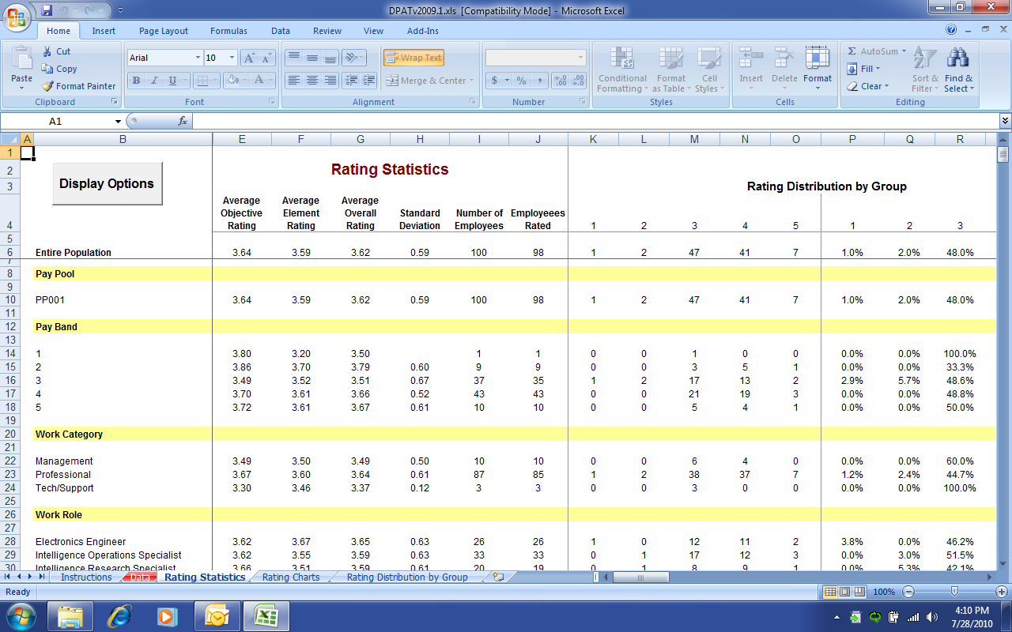
DPAT Sample Rating Statistics Worksheet
21
Notes:
Speaker Notes:
The DPAT provides an overview of ratings in the Rating Statistics worksheet. This worksheet displays the average rating, average element rating, average overall rating, standard deviation, number of employees, number of employees rated, and the rating distributions by ratings.
The statistics provide data by work category, work role, occupational series, rating official, reviewing official, and directorate/organization.
This is a good place for the PM PRA to begin by seeing an overall rating distribution.

Slide 22
Typical DCIPS Rating Distribution
This graph represents a potentially ordinary DCIPS rating distribution.
An ordinary rating distribution is one where there are more Level 4 ratings than Level 5 and more Level 3 ratings than Level 4 and very few Level 1 and 2 ratings.
This rating distribution is not mandated (or forced); this is the most likely outcome of the fair and consistent application of the standardized performance descriptors under DCIPS.

Slide 23
Inflated DCIPS Rating
The graph represents an inflated ratings distribution with majority of the ratings in level 5, less at level 4, even fewer at level 3 and below.
The DCIPS rating system is designed to make meaningful distinctions in rewarding performance, inflated ratings have a number of negative consequences:
Decreases employee credibility in the system and does not allow for meaningful performance distinctions for high performers.
Reduces the positive motivation for the high performers because their achievements are not acknowledged and rewarded appropriately.
Notes:
Too many high ratings diminish the value of a bonus in each pay pool if everyone receives the same rating, the bonus amount is limited. For example, if 10 people in a pay pool receive a 4.7 rating, they will all receive the same dollar amount. Whereas, if there is a more meaningful distinction made, those with higher ratings receive increased dollar amounts.

Slide 24
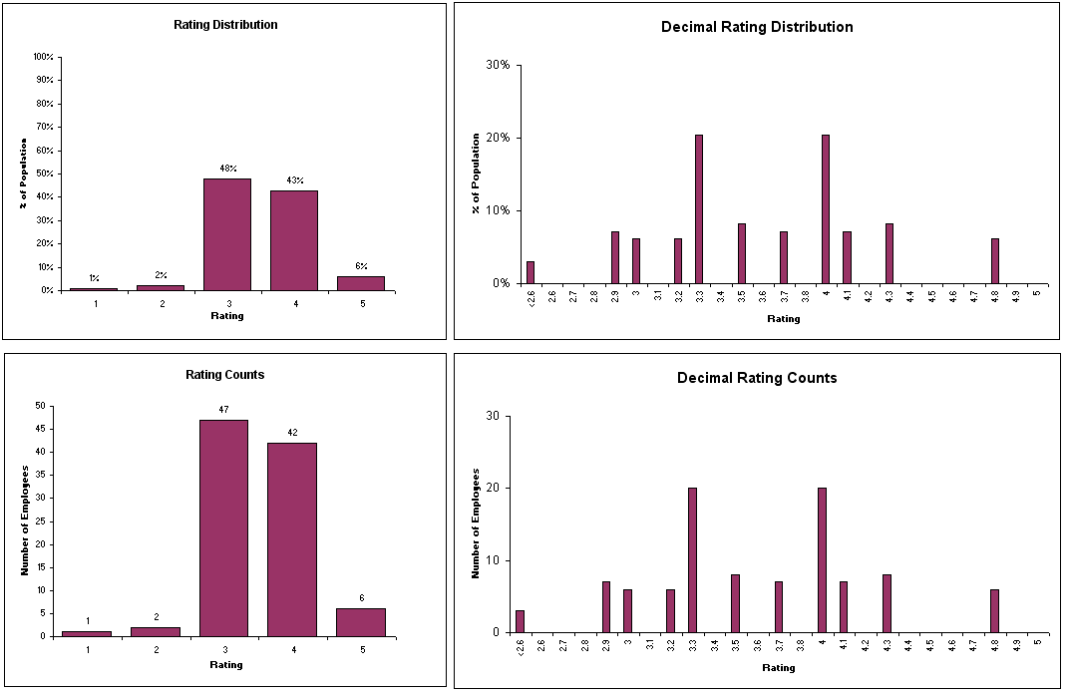
Potential DPAT Rating Charts
Notes:
Speaker Notes:
The Rating Charts worksheet provides bar charts showing the rating distribution of all the employees with a rating. The top left chart shows the percentage distribution by integer rating, and the top right chart shows the percentage distribution by decimal rating.
The bottom left chart shows the count of employees by integer rating, and the bottom right chart shows the count of employees by the decimal rating.
This rating distribution is not mandated (or forced).

Slide 25
Additional Levels of Analysis
PM PRA can request additional data analysis on various dimensions such as directorate, occupational series, rating/reviewing officials and grade levels.
PM PRA can request additional information from a different organization/team that may validate anomalies or skewed rating distributions.
When necessary, PM PRA may request more in-depth information (i.e., performance evaluations) to resolve potential rating inconsistencies.
Notes:
Speaker Notes:
If the PM PRA sees that there are ratings anomalies, such as too many high or low ratings, he/she can request to see the actual evaluation of record to understand the specifics of how the rating was applied.
It is important to note that inflated ratings could decrease employee credibility in DCIPS rating system. In addition, only 50 percent in each pay pool receive performance-based bonuses (base-pay increase monetary awards (DQIs/SQIs) do not count towards the 50 percent, they are capped in the range of 1-10% of the Command’s upper scores as shown on the CWB); therefore, making meaningful distinctions in performance will allow those who are truly high performer to receive a more appropriate reward.
Too many high ratings diminish the value of a performance-based bonus in each pay pool if everyone receives the same rating, the performance-based bonus amount is limited. For example, if 10 people in a pay pool receive a 4.7 rating, they will all receive the same dollar amount. Whereas, if there is a more meaningful distinction made, those with higher ratings receive increased dollar amounts.

Slide 26
Resolving Rating Inconsistency
After PM PRA identifies a rating inconsistency they may want to take the following actions:
Discuss discrepancies with reviewing official(s).
Suggest corrective action prior to approval to ensure the ratings are supported by the written narrative:
Recommend changes to narrative pertaining to performance objectives and elements and/or to the rating; if rating/reviewing officials are unavailable or unwilling to make changes to comply with merit system principles and DCIPS policy, the PM PRA may make the necessary changes to ensure compliance. Note: Numerical ratings and narratives must support the rating if a particular objective or element rating changed.
The PM PRA can direct changes to performance evaluations.
Notes:
Speaker Notes:
If the PM PRA sees that there are ratings anomalies, such as too many high or low ratings, he/she can request to see the actual evaluation of record to understand the specifics of how the rating was applied.
It is important to note that inflated ratings could decrease employee credibility in DCIPS rating system. In addition, no more than 50 percent in each pay pool are initially eligible to receive performance-based bonuses; therefore, making meaningful distinctions in performance will allow those who are truly high performer to receive a more appropriate reward.

Slide 27
Modal Rating Decision
It is the responsibility of the PM PRA to determine the modal rating when the employee falls within one of the following specially-situated employees categories & a presumptive rating can not be given:
Absent to Perform Military Service
Absent on Worker’s Compensation
Absent due to other Special Circumstances IAW policy (long-term training)
Modal ratings can only be identified once all other ratings have been assigned.
The modal rating is:
Determined at the first level of PM PRA review.
The most commonly-given rating for other employees under the purview of the same PM PRA.
In cases where there is more than one modal rating, the higher rating is the approved modal rating.
Notes:
Speaker Notes:
One of the duties of the PM PRA is to determine a modal rating for those employees that do not have an evaluation of record. Examples of employees might be someone who is called to active duty.
The Mode is a statistical term that indicates the most frequent number. The mode is NOT a mean (i.e., average). In DCIPS it is the most frequently given rating to the tenth decimal place (i.e., 3.4).
For specially situated employees, the modal rating is assigned as determined at the first level of PM PRA review. The modal rating is the most commonly given rating for other employees under the purview of the same PM PRA. In cases where there is more than one mode (i.e., nine 3.3s and nine 3.4s) the higher rating will be the modal rating.

Slide 28
Completing the PM PRA Process
PM PRA should officially notify the organization of the following:
PM PRA process has been completed.
Ratings can be approved and released in the PAA Tool.
The modal rating for any specially-situated employees, if applicable.
Performance evaluation conversations may begin between the rating official and employee.
Performance Based Compensation Program (Pay Pools) may proceed.
Notes:
Speaker Notes:

Slide 29
Resources
Rater Consistency Handbook
Attendee: http://g2-public-website.azurewebsites.us/site/dcips/docs/Lifecycle/ER/Rater_%20Consistency_Handbook_(Guide_for_Attendee).pdf
Notes:
Assists management teams in understanding and implementing rater consistency.

Slide 30
BACKUP Slides

Slide 31
Overall DCIPS Performance Rating Standards
Performance Rating | General Standard
OUTSTANDING 4.6-5.0 | The employee’s overall contribution, both in terms of results achieved and the manner in which those results were achieved, has extraordinary effects or impacts on mission objectives that would not otherwise have been achieved. Only a few employees achieve this level of exemplary, benchmark performance.
EXCELLENT 3.6-4.5 | The employee’s overall contribution, both in terms of results achieved and the manner in which those results were achieved, has significant impact on mission objectives.
SUCCESSFUL 2.6-3.5 | The employee’s overall contribution, both in terms of results achieved and the manner in which those results were achieved, has made a positive impact on mission objectives. It is expected that the majority of employees will achieve this level of performance.
MINIMALLY SUCCESSFUL 2.0-2.5 | The employee’s overall contribution to mission, although positive, have been less than that expected.
UNACCEPTABLE <2 or 1 on any objective | The employee received an unacceptable rating on one or more performance objectives.

